Slide 1
Railway Ticket Verification

Slide 2
Abstract:
.
Railways is the most convenient, affordable means of transport in India.
So keeping this in view, in this paper we propose a platform where we are presenting a model which verifies the railway ticket when passengers arrives to their particular destination. Nowadays, ticket verification is done by person to person via train ticket checker (TTC), and it becomes quiet difficult for them to check each and every persons ticket and verify it.
The Indian Railways are upgrading in a large scale and e-ticketing, Rail wire, Wi-Fi services where we can see everything is being processed in a digital form.
A straightforward theoretical model is projected that once enforced might lead to a better management of the tedious ticketing mechanism. This will improve the productivity of the Railways and will boost the “Digital India” campaign.

Slide 3
Introduction:
The ticket reservation system of Indian Railways has moved from offline to online, making it convenient for people with smartphones and a stable internet to book tickets online.
Ticketing system for railways was introduced to display and authorize valid passengers to suit one’s comfort, purpose or wants while travelling.
Peoples who were travelling through trains were vastly incremented, resulting in causing problems, like never ending queues, wastage of paper, useless resource and staff utilization. The Indian Railways are upgrading in a large scale and e-ticketing, Rail wire, Wi-Fi services where we can see everything is being processed in a digital form.

Slide 4
Literature Survey:
The literature survey on the railway Ticket Checking system is done by visiting the websites and related paper published on the railway ticket checking system.
There is various technique which we come to seen in the literature review for ticket checking in railway. The techniques are:

Slide 5
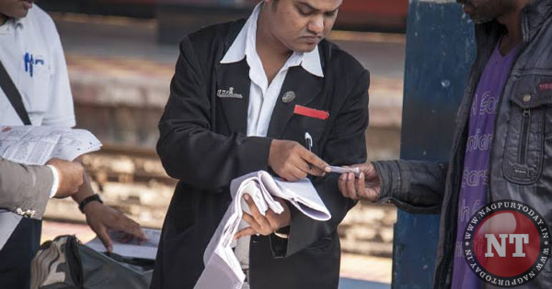
Traditional system:

Slide 6
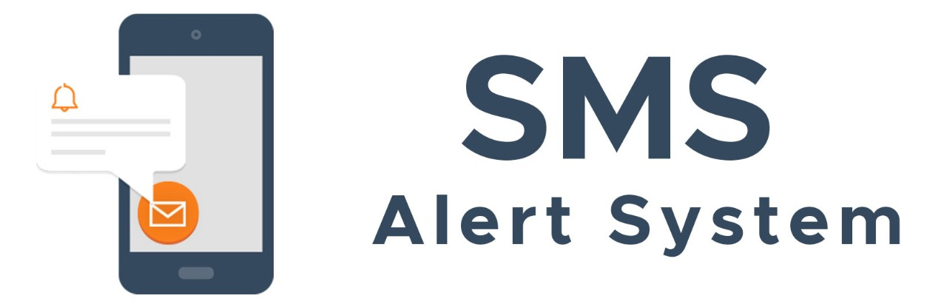
SMS Alert system:

Slide 7
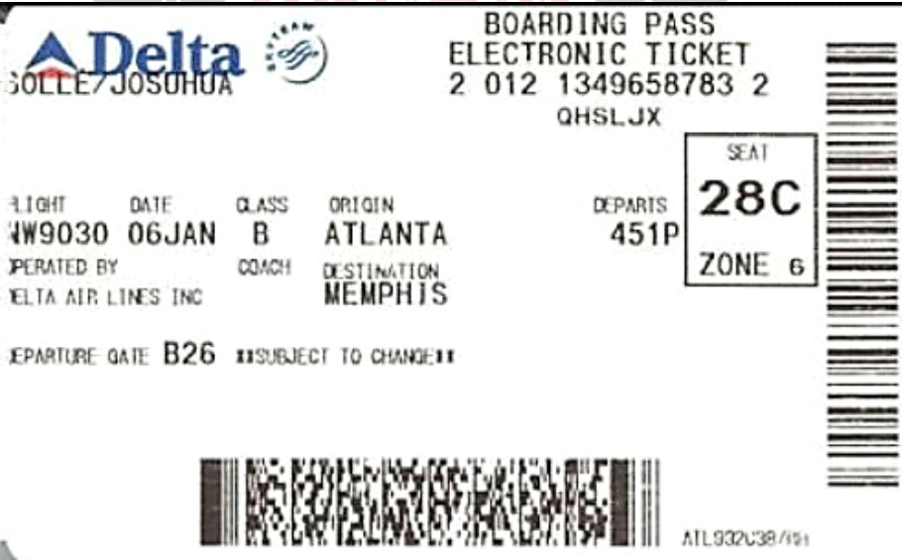
Barcode Ticket Scanning:

Slide 8
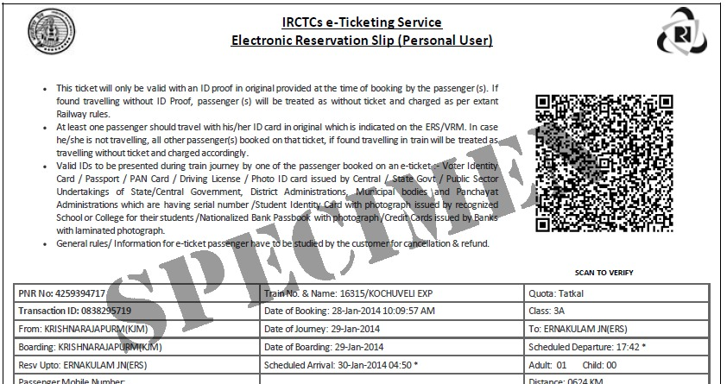
QR Code Scanning System:

Slide 9
Problem Statement:
As we all know that Indian railway system has grown in a large extent and people travelling through railways have been increased year by year, so while reaching destination they rush towards the station exit without proper ticket checking, and all the tickets were checked by few personals in the station, hence efficient checking were not conducted due to huge crowds of passengers exits at once, so we are introducing an automated ticket checking system.
Aim:
To automate the former railway ticket checking system.

Slide 10
Objectives:
The main aim from this research analysis is to automate the former railway ticket checking system which consists of manual checking by personals and which is not efficient, so we are proposing a ticket checking system based on digital image processing and machine learning.

Slide 11
Methodology:
In this study, a new computer vision-based method is proposed for automated Railway ticket verification. There is image processing based several techniques in the literature.
The Steps in the image processing system are as follows:
Information of tickets is stored by scanning tickets in the machine using optical sensor.
Fetched information were stored in server for further operation.
Stored information in the server were compared with the existing booking information

Slide 12
Dataset

Slide 13
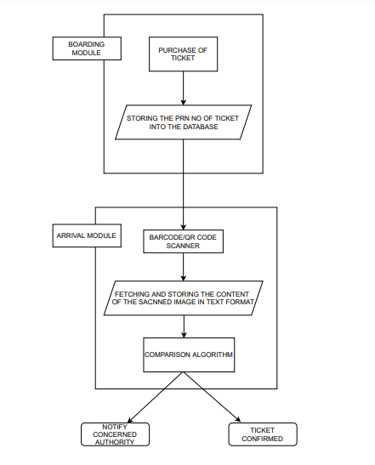
Block Diagram:

Slide 14
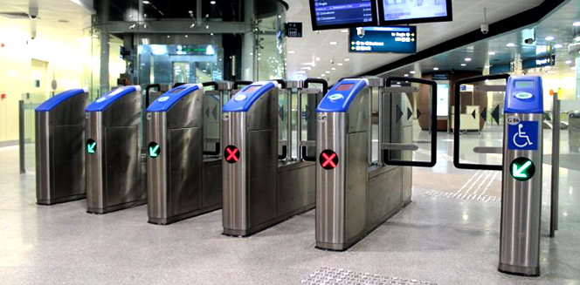
Replica of our proposed system

Slide 15
System Specification and Requirements:
Barcode Scanner
QR Code Scanner
Tesseract OCR /easyocr (Library)
Py tesseract (Library)
Supports up to 7500 concurrent users. (Server Specification)
1 TB of disk space for cache
16 CPU cores (intel xeon/AMD optane)
64 GB RAM (3678mhz of high speed ddr4x memory)
System Algorithm:
Our system algorithm’s working includes storing the information in different server location, retrieving the previous information and compare it with the current stored information

Slide 16
References:
www.Irjet.Net
www.Indianrail.Gov.In
Biometric ticketing system for railway,somnath sarkar,indian institute of hardware technology,kolkata ,west bengal, india,dipankar chatterjee,computer application department,guru nanak institute of technology, sodepur, west bengal, india.
E-kyc ticketing system yogesh suman, 1srm university, kattankulathur kancheepuram, chennai, ms. G. Geetha ,2SRM university, kattankulathur kancheepuram, chennai.
Biometric based smart railway reservation system with sms facilityp. Naren suchendra das, G. Bhargavi, G. Ravindranath kumar, Biometric based smart railway reservation system with sms facility. Vol. No. 2, issue 10, october 16.
Revits: railway e-verification information and ticketing system. Sourodeep chatterjee, soham das, divisha, bhaskar goswami, pallab nag and chittaranjan pradhan. July 28 - 30, 2020, india.
Required characteristics of the ticketing systems for reservation-compulsory commuting railways. Ryo takagi.

Slide 17
MEMBERS & CONTRIBUTIONS:
 | NAME | CONTRIBUTIONS
1132200544 | RANJAN SUTRADHAR | Suggested the Topic, Code implementation, literature surveys analysed
1132200404 | RUSHIKESH GOSKI | Collected the required information regarding the topic, Code implementation, 3 literature surveys analysed.
1132200230 | ADITYA JOSHI | Created the dataset,3 literature surveys analysed
1132200500 | PIYUSH DATIR | Suggested the system algorithm and specifications, Code implementation, 3 literature surveys analysed
1132200246 | ADITYA DORWEKAR | Documentation, Presentation, 3 literature surveys analysed

Slide 18
THANKS!

